Slide 1
Kratos Multiphysics Fluid Dynamics Application
4th Kratos Multiphysics workshop
Rubén Zorrilla
Jordi Cotela
Riccardo Rossi
Javier Gárate

Slide 2
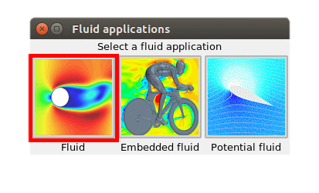
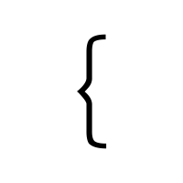
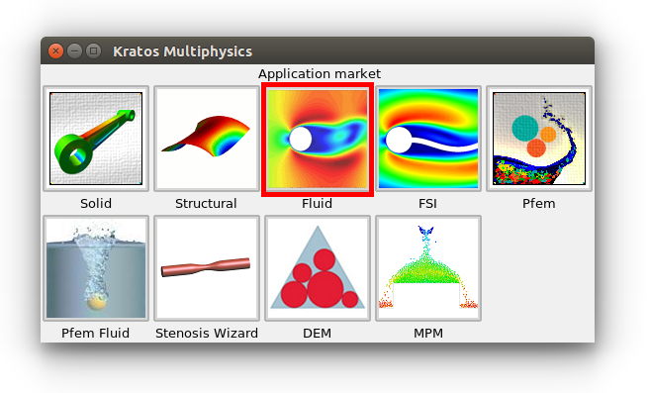
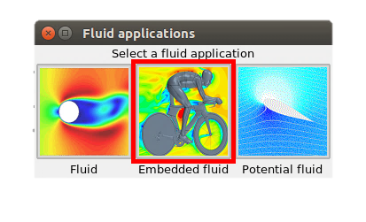
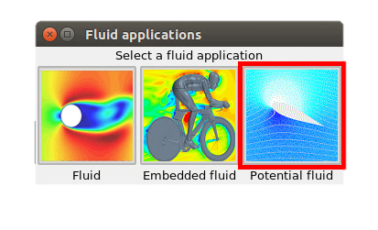
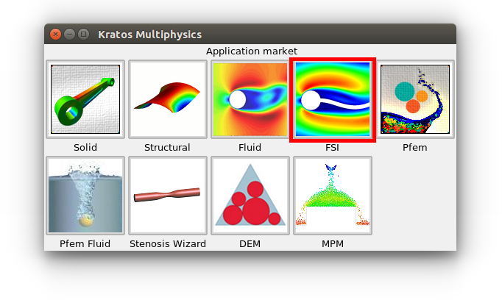
Kratos Multiphysics Fluid Dynamics Application What is ready to use in the GUI?
Currently, the fluid dynamics GUI supports:
2D & 3D body fitted CFD
3D embedded fluid (VWT)
2D & 3D potential flow
Complementary,
Coupled with the FSI application GUI

Slide 3
Kratos Multiphysics Fluid Dynamics Application But much more is available…
Embedded slip formulation (Rubén Zorrilla)
Discontinuous embedded formulation (Rubén Zorrilla)
Explicit FM-ALE embedded formulation (Rubén Zorrilla)
Compressible Navier-Stokes equations (Jordi Cotela)
Turbulence modelling (Jordi Cotela)
Non-Newtonian constitutive models (Jordi Cotela and Antonia Larese)
Free-surface and two-fluid formulations (Antonia Larese and Pablo Becker)
Shallow water (Miguel Masó)
Swimming DEM (Guillermo Casas)
…
Presented from 12.40 to 13.30 in Kratos – CIMNE research lines talk (P. Dadvand)

Slide 4
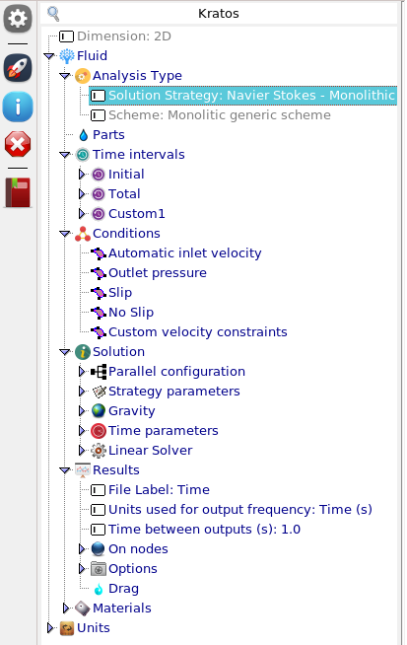
Kratos Multiphysics Fluid Dynamics Application 2D & 3D body fitted CFD
Main contents:
Fractional step and monolithic formulations
VMS stabilization (ASGS or OSS subscales modelling)
OpenMP and MPI support
New features:
Automatic time stepping based on CFL
f(x) and automatic inwards inlet support
More user-friendly solution and solver settings
Drag & lift computation

Slide 5
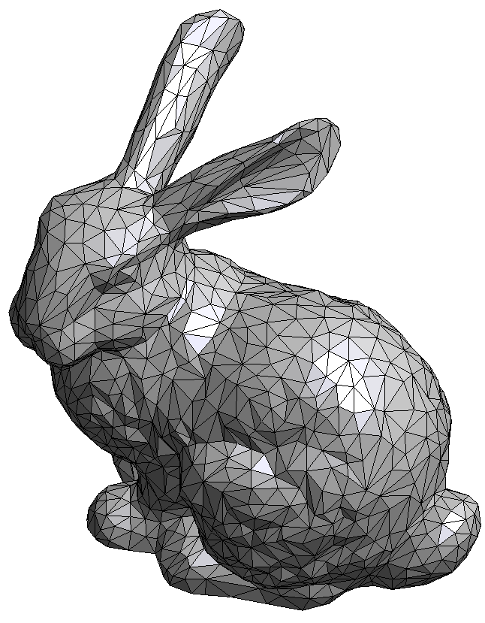
Kratos Multiphysics Fluid Dynamics Application 3D embedded fluid (VWT)
Embedded fluid interface → Virtual Wind Tunnel (VWT) concept
Drop, mesh and compute
Aimed to accelerate the model generation by:
Dropping the immersed object (.stl, .obj, …)
Simplifying the bounding box generation
Embedded octree meshing (no clean up & robustness)
Object representation using a level set function

Slide 6
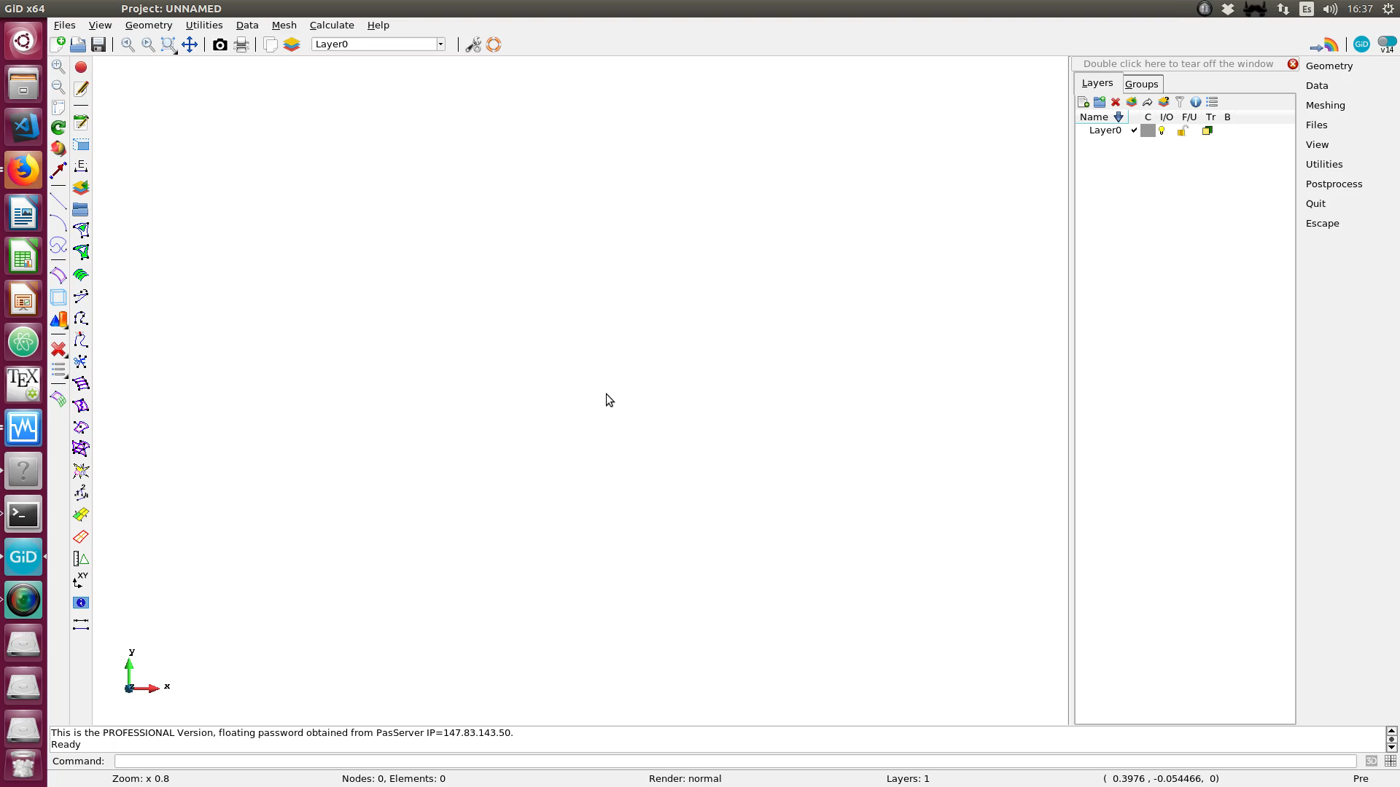
Kratos Multiphysics Fluid Dynamics Application 3D embedded fluid (VWT)

Slide 7
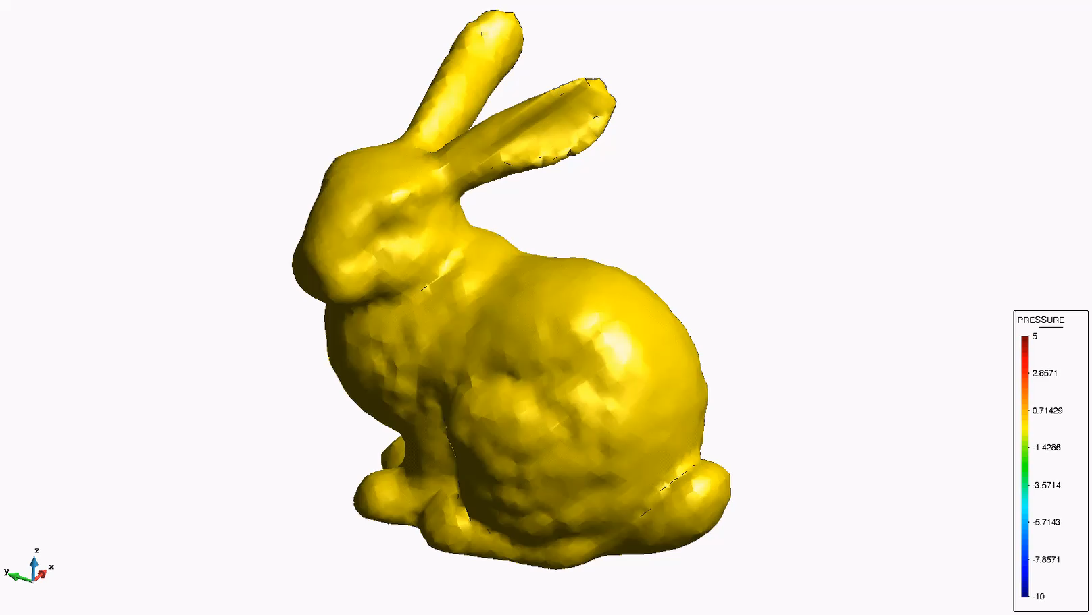
Kratos Multiphysics Fluid Dynamics Application 3D embedded fluid (VWT)

Slide 8
Kratos Multiphysics Fluid Dynamics Application 2D & 3D potential flow
Comment on the contents
How to use it?

